Slide 1
Linux commands
Tech Training Team

Slide 2
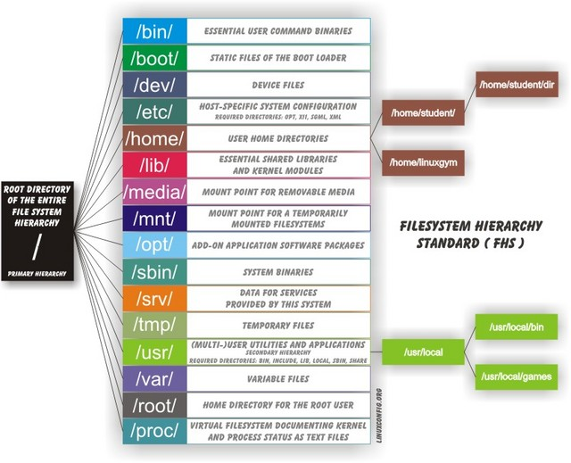
File system Hierarchy

Slide 3
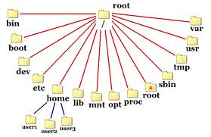
File system Hierarchy

Slide 4
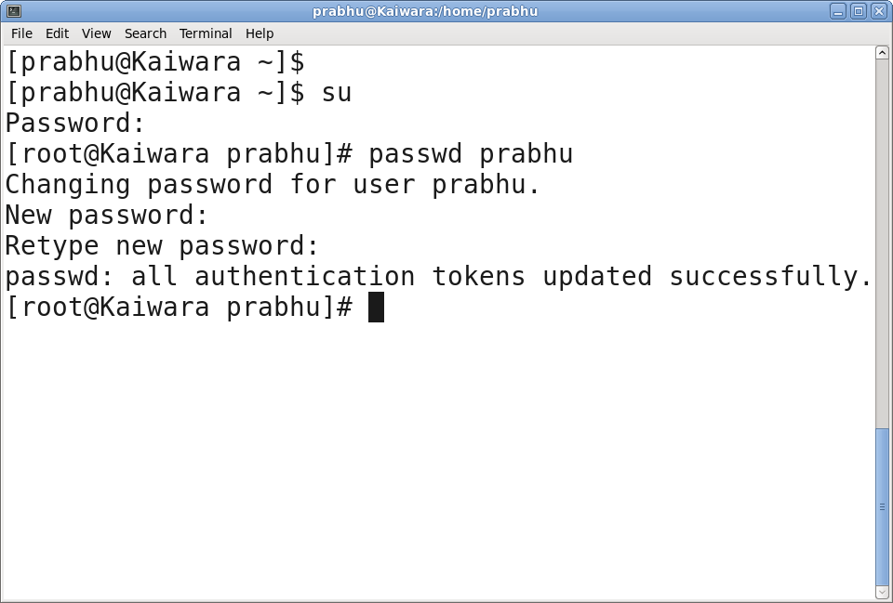
Change user password

Slide 5
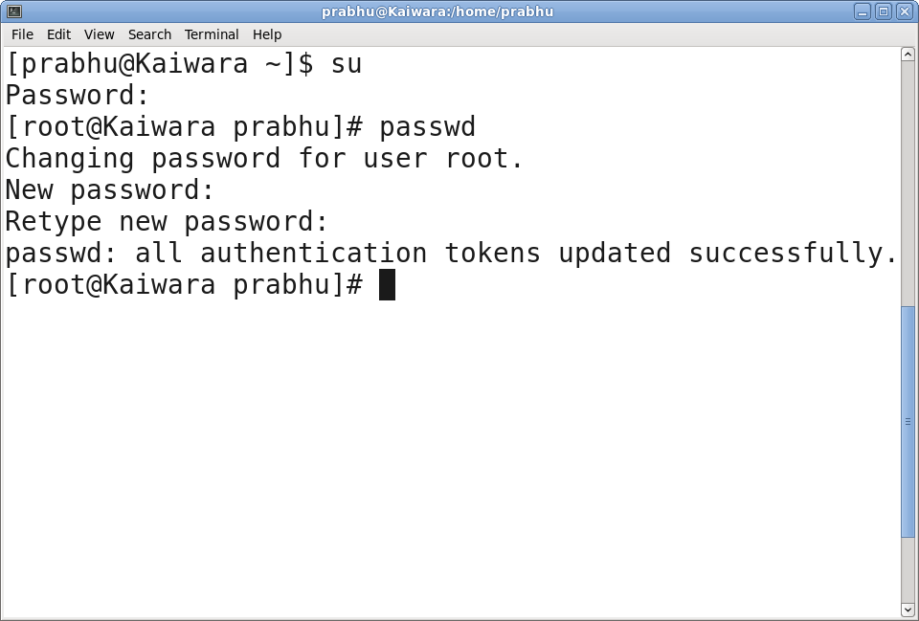
Change root password

Slide 6
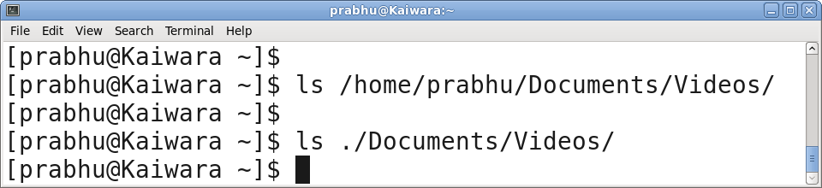
Absolute and Relative paths

Slide 7
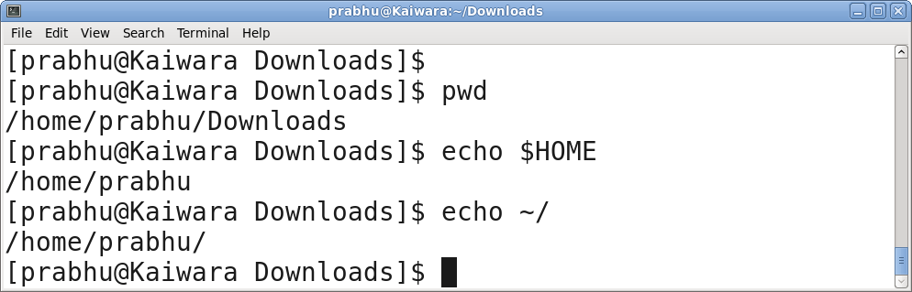
PWD & HOME dirs

Slide 8
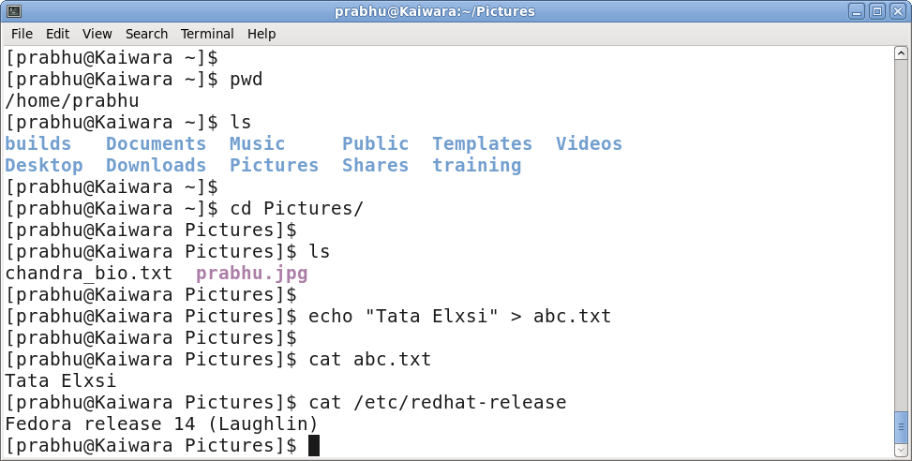
File System commands

Slide 9
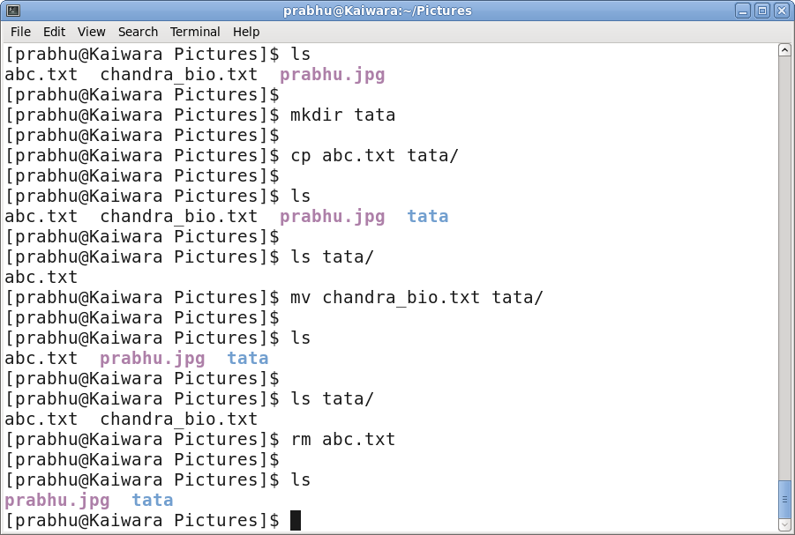
File System commands

Slide 10
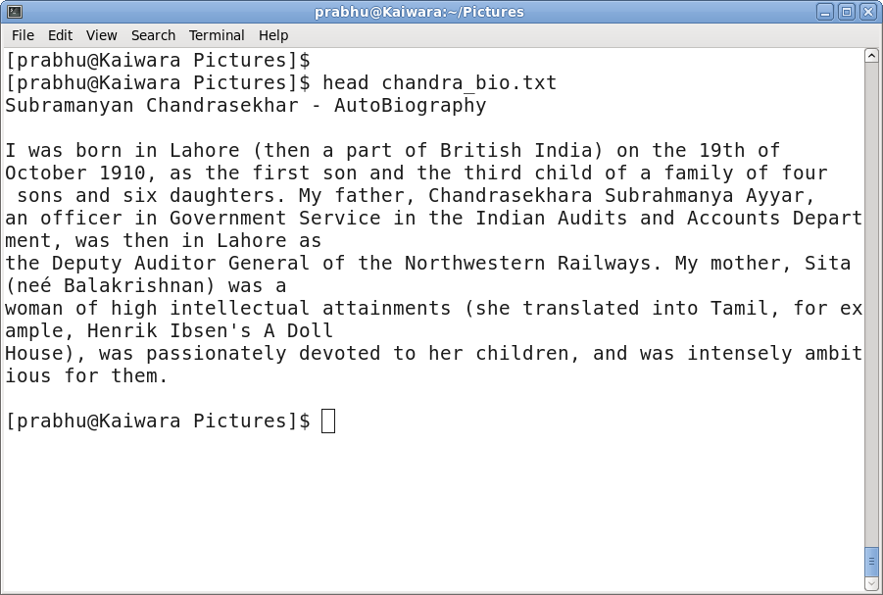
File System commands

Slide 11
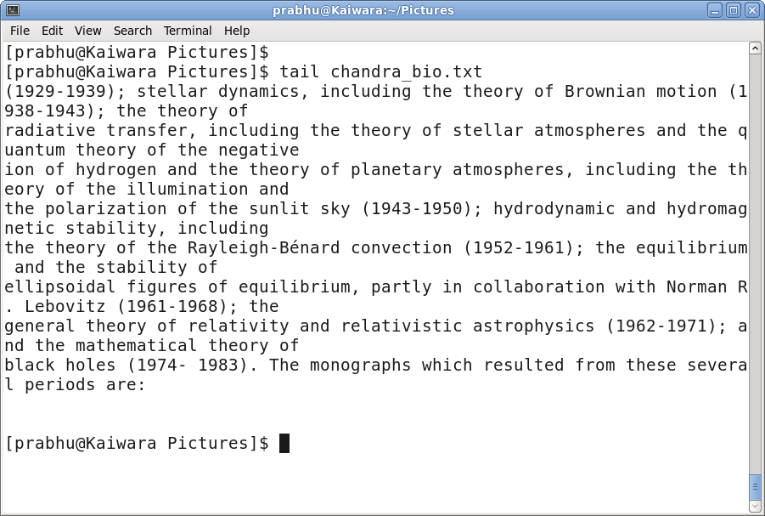
File System commands

Slide 12
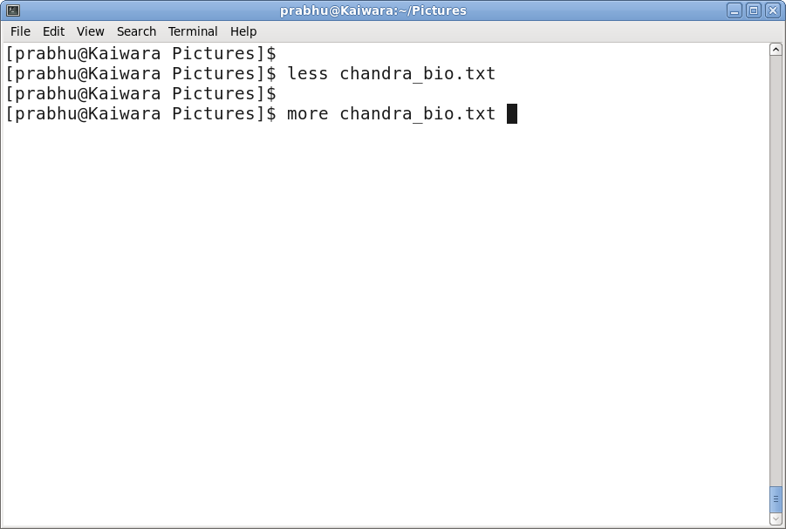
File System commands

Slide 13
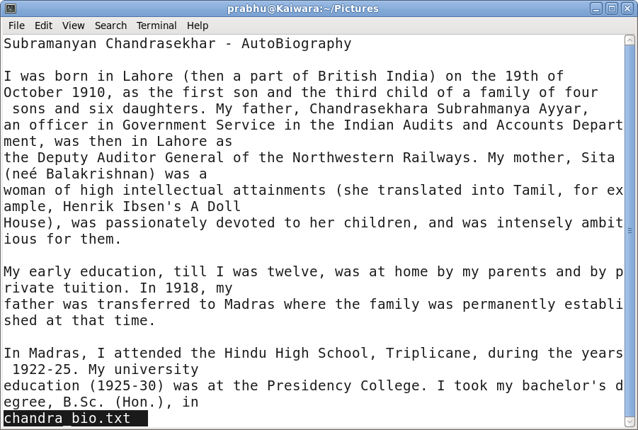
File System commands

Slide 14
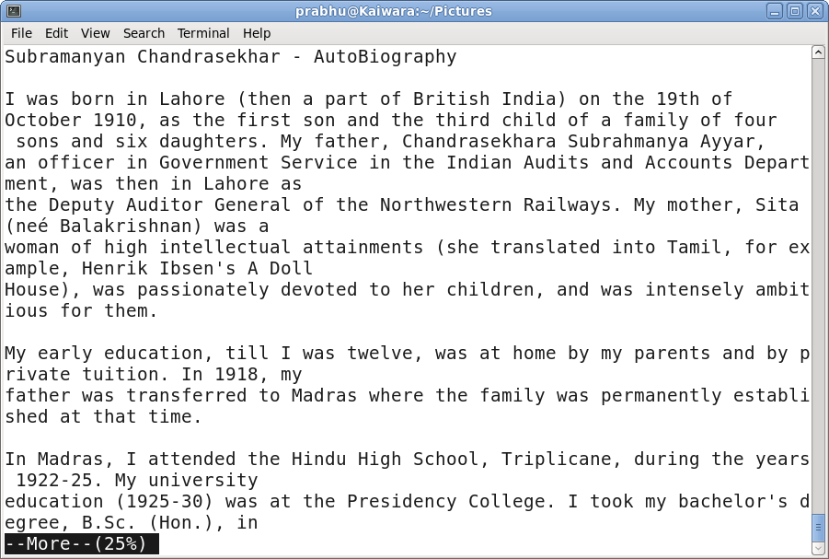
File System commands

Slide 15
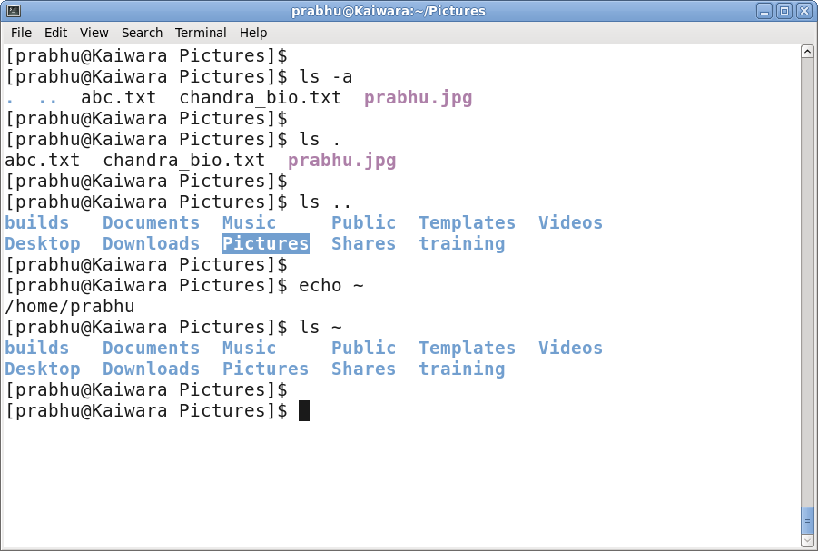
File System commands

Slide 16
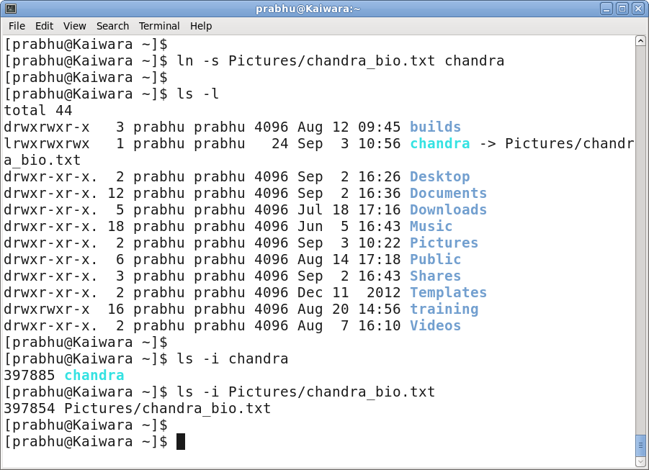
File System commands

Slide 17
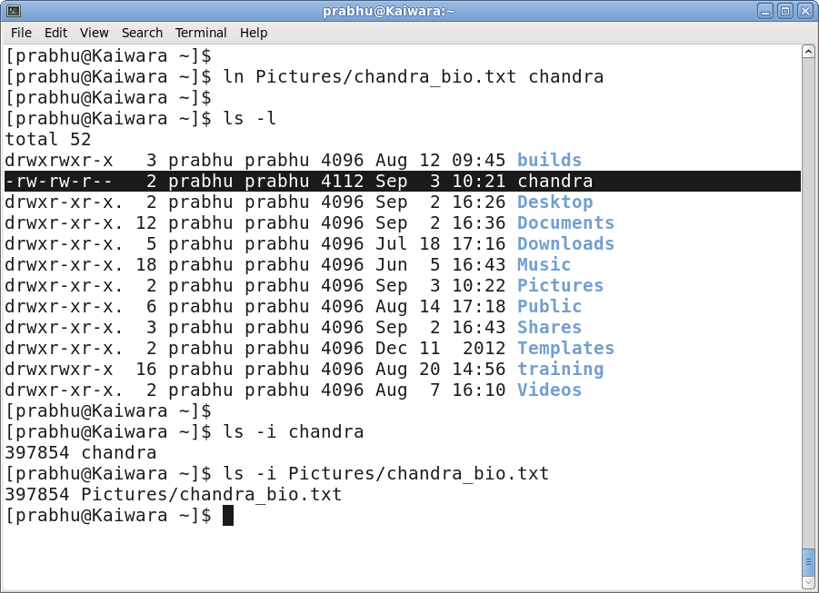
File System commands

Slide 18
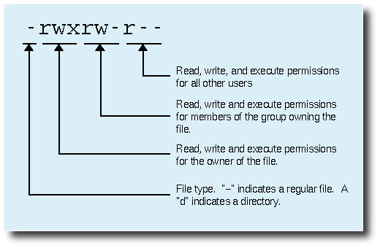
File System Security

Slide 19
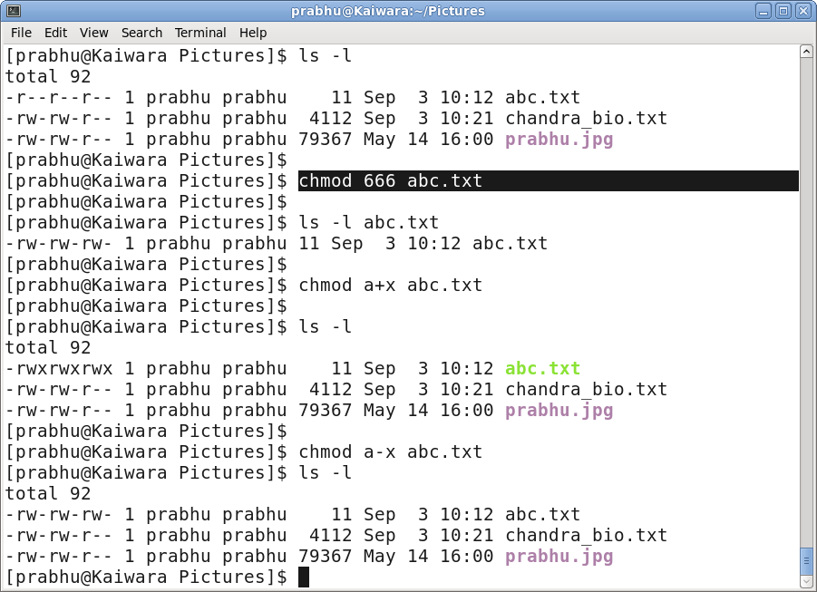
File System security

Slide 20
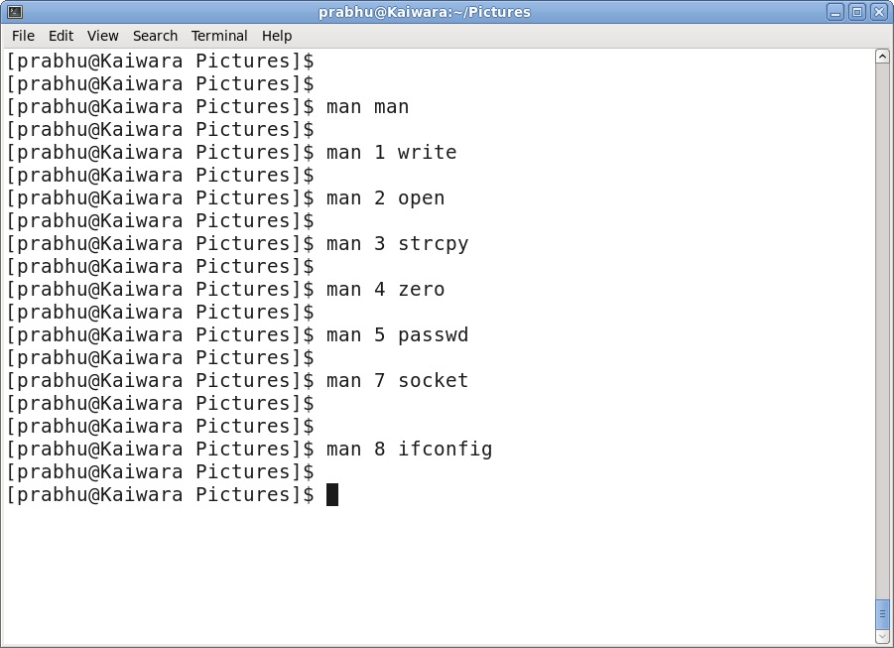
Linux Generic Commands

Slide 21
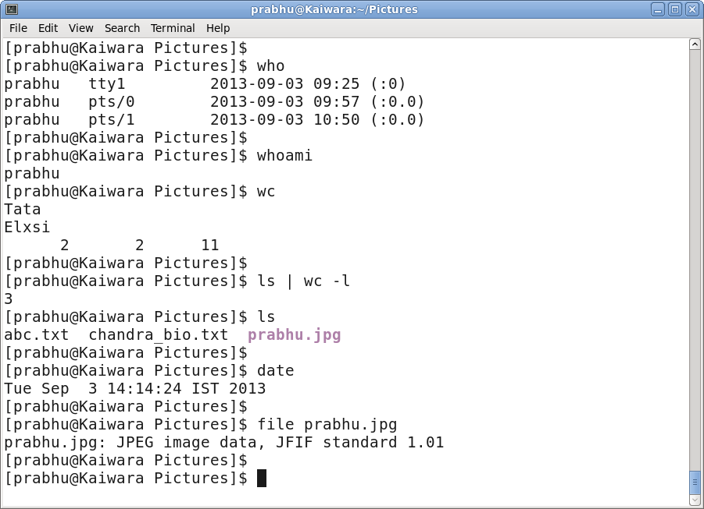
Linux Generic Commands

Slide 22
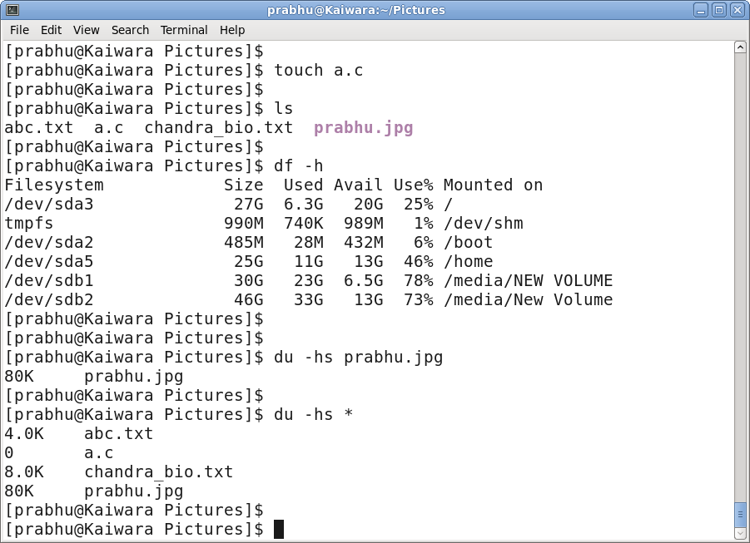
Linux Generic Commands

Slide 23
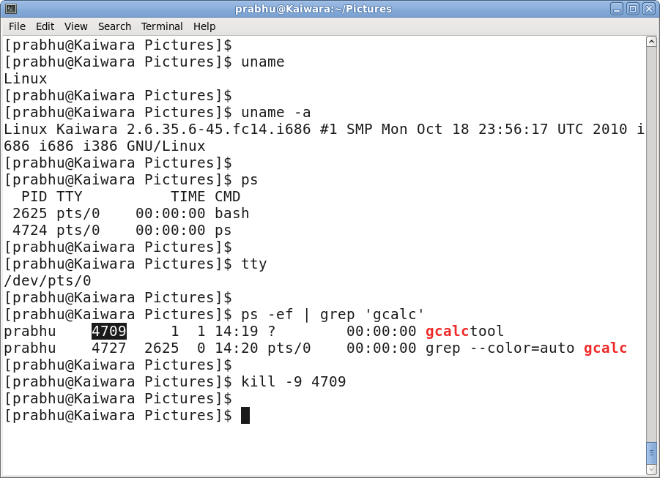
Linux Generic Commands

Slide 24
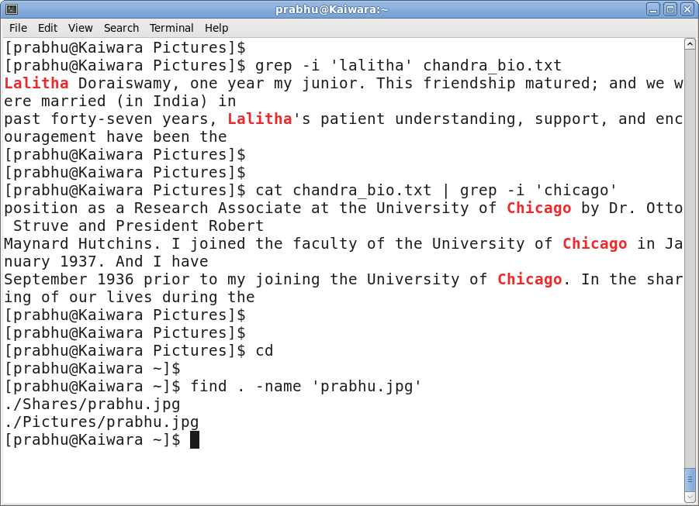
Linux Generic Commands

Slide 25
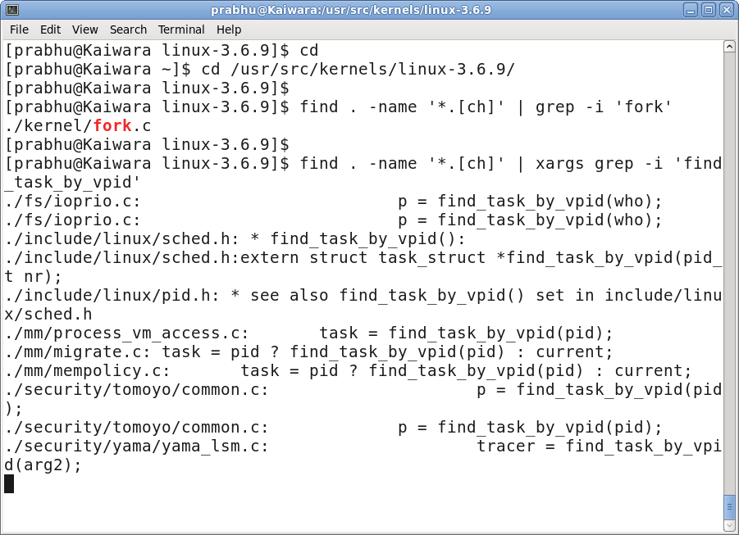
Linux Generic Commands

Slide 26
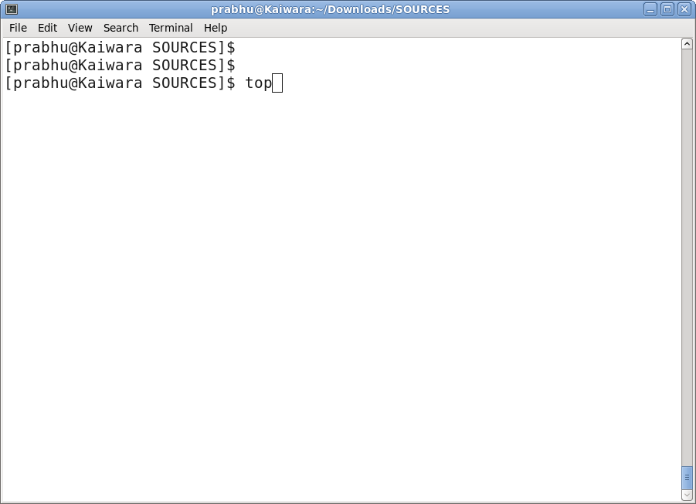
Linux Generic Commands

Slide 27
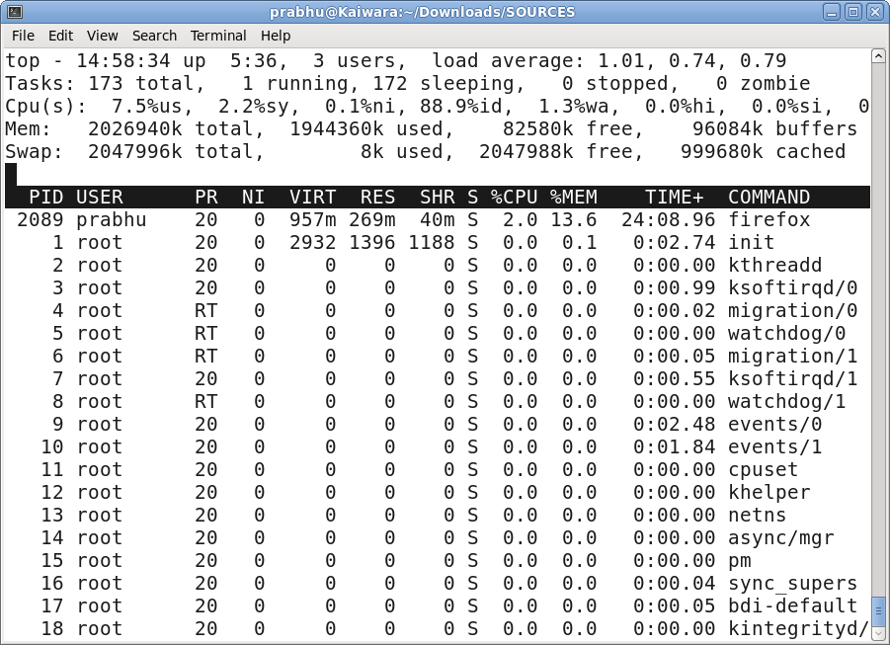
Linux Generic Commands

Slide 28
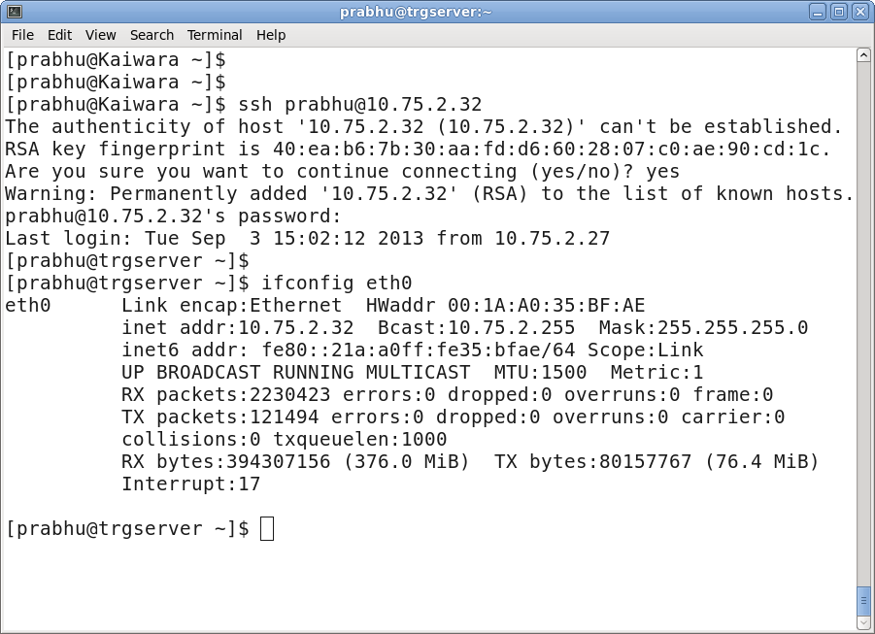
Linux Generic Commands

Slide 29
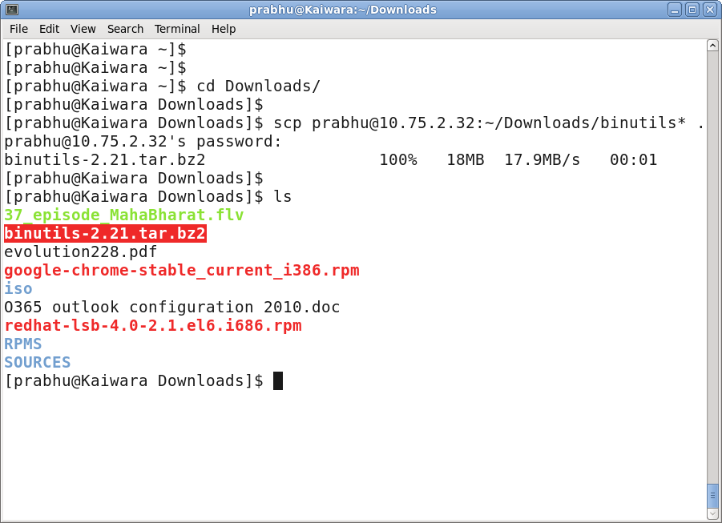
Linux Generic Commands

Slide 30
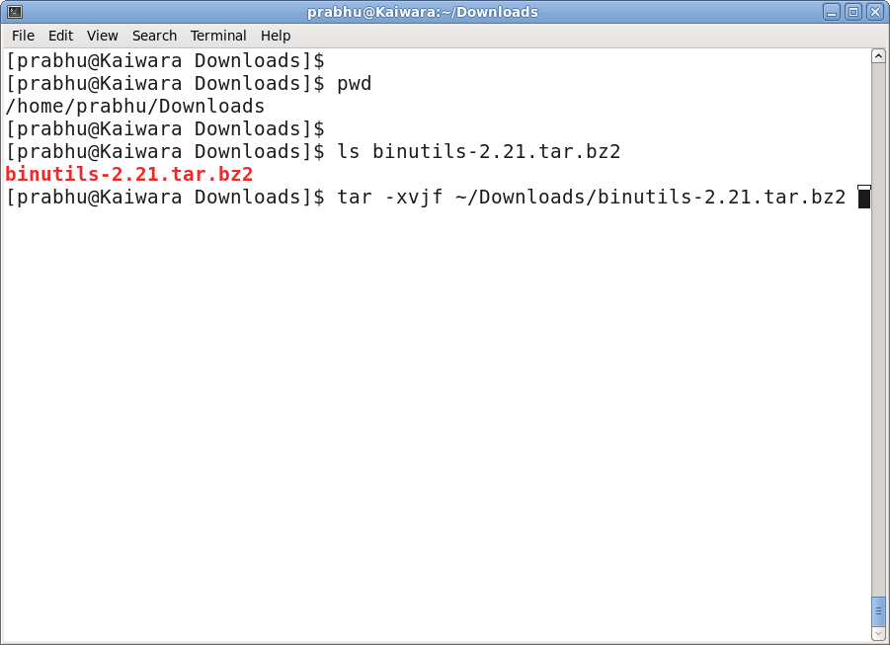
Linux Generic Commands

Slide 31
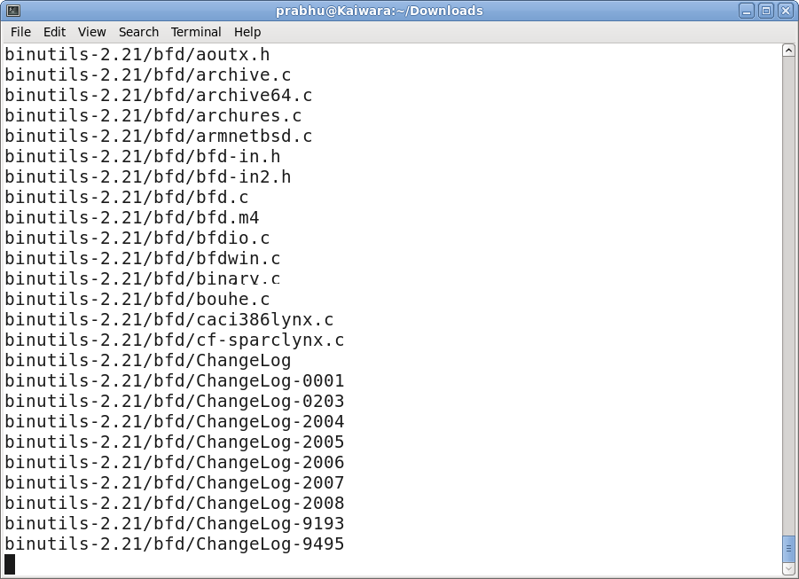
Linux Generic Commands

Slide 32
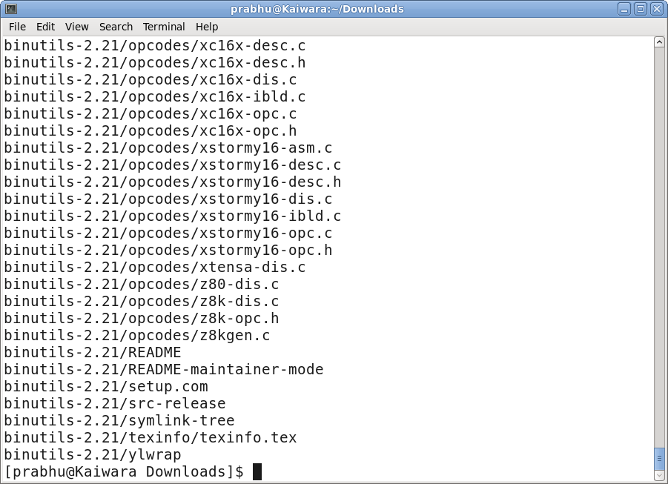
Linux Generic Commands

Slide 33
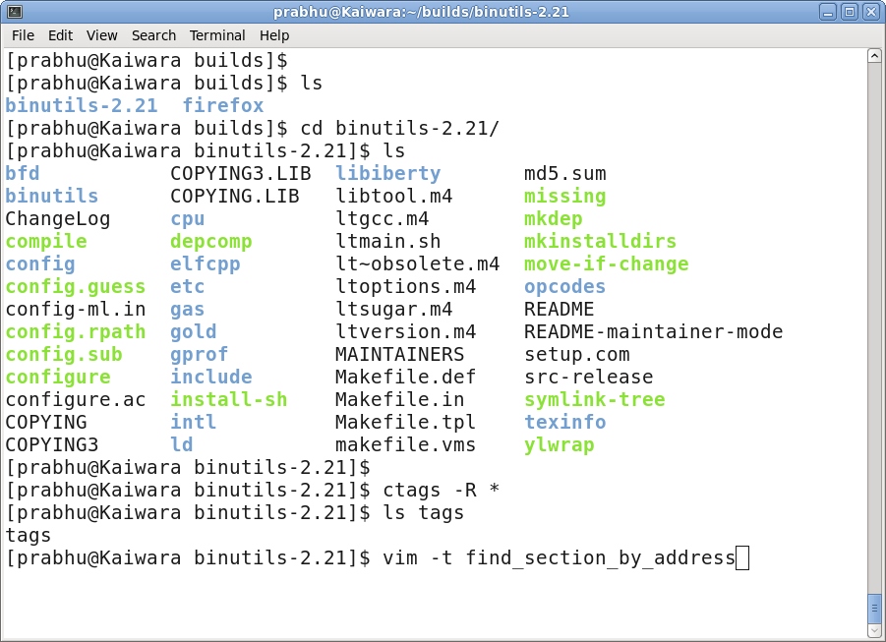
Linux Generic Commands

Slide 34
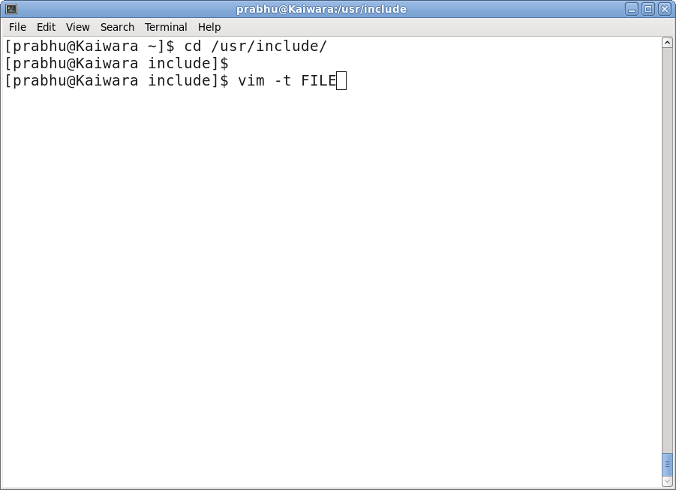
Linux Generic Commands

Slide 35
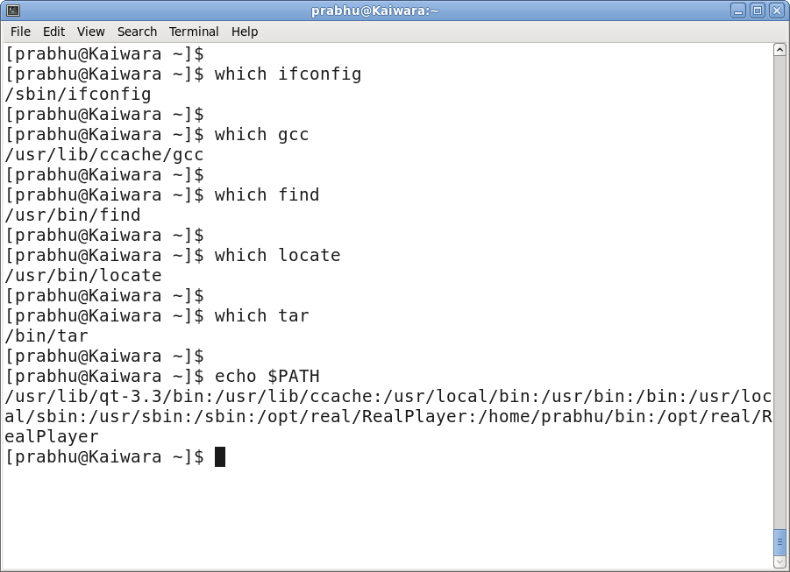
Linux Generic Commands

Slide 36
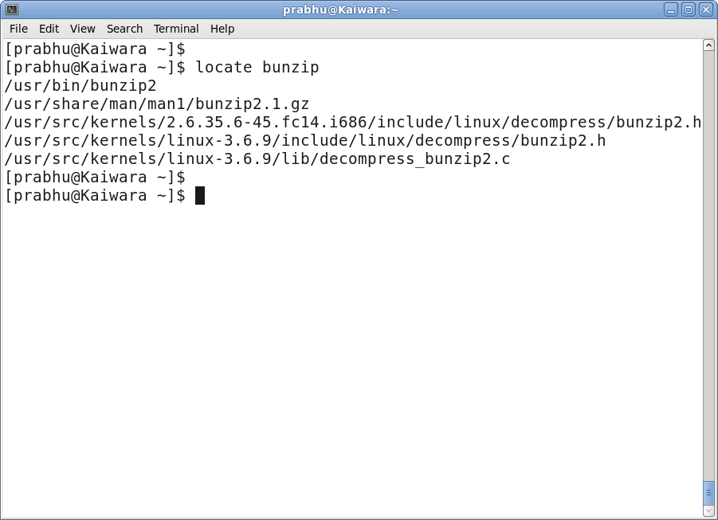
Linux Generic Commands

Slide 37
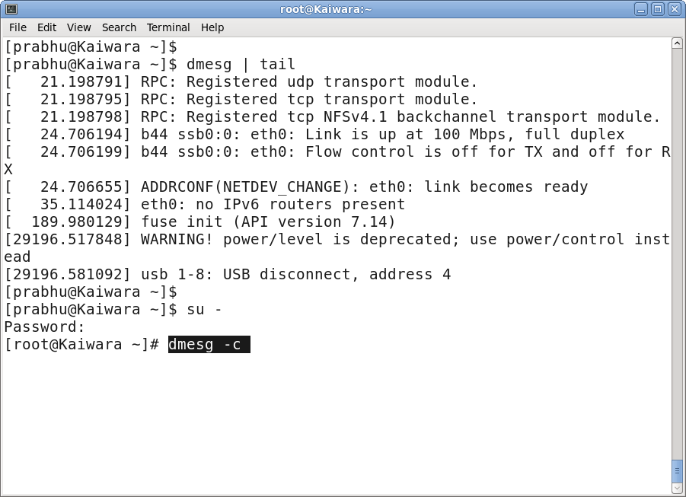
Linux Generic Commands

Slide 38
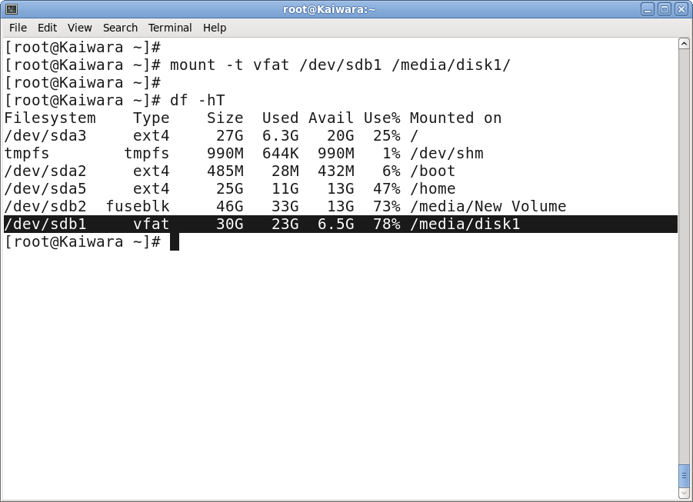
Linux Generic Commands

Slide 39
Vim Editor
VIM - Text editor
A text editor used to useful for editing programs like C, C++, Java,
and scripting languages like shell, PERL, PYTHON, TCL.
* How to open a file
$ vim hello.c

Slide 40
Vim Editor
Vim operates in two modes.
insert mode
Data can be entered, edited...
Command mode
operate on the data like cut, copy, paste, navigate...

Slide 41
Vim Commands
Basics
:e filename Open filename for edition
:w Save file
:q Exit Vim
:q! Quit without saving
:x Write file (if changes has been made) and exit
:sav filename Saves file as filename
. Repeats the last change made in normal mode
5. Repeats 5 times the last change made in normal mode

Slide 42
Vim Commands – Moving in the file
k or Up Arrow move the cursor up one line
j or Down Arrow move the cursor down one line
e move the cursor to the end of the word
b move the cursor to the begining of the word
0 move the cursor to the begining of the line
G move the cursor to the end of the file
gg move the cursor to the begining of the file

Slide 43
Vim Commands – Moving in the file
L move the cursor to the bottom of the screen
:59 move cursor to line 59. Replace 59 by the desired line number.
20| move cursor to column 20.
% Move cursor to matching parenthesis
[[ Jump to function start
[{ Jump to block start

Slide 44
Vim commands – Cut, Copy, Paste
y Copy the selected text to clipboard
p Paste clipboard contents
dd Cut current line
yy Copy current line
y$ Copy to end of line
D Cut to end of line

Slide 45
Vim Commands - Search
/word Search word from top to bottom
?word Search word from bottom to top
* Search the word under cursor
/\cstring Search STRING or string, case insensitive
/jo[ha]n Search john or joan
/\< the Search the, theatre or then
/the\> Search the or breathe

Slide 46
Vim Commands - Search
/\< the\> Search the
/\< ¦.\> Search all words of 4 letters
/\/ Search fred but not alfred or frederick
/fred\|joe Search fred or joe
/\<\d\d\d\d\> Search exactly 4 digits
/^\n\{3} Find 3 empty lines

Slide 47
Vim commands - Search
:bufdo /searchstr/ Search in all open files
bufdo %s/something/somethingelse/g Search something in all the open buffers and replace it with somethingelse

Slide 48
Vim commands - Replace
:%s/old/new/g Replace all occurences of old by new in file
:%s/onward/forward/gi Replace onward by forward, case unsensitive
:%s/old/new/gc Replace all occurences with confirmation
:2,35s/old/new/g Replace all occurences between lines 2 and 35

Slide 49
Vim commands - Replace
:5,$s/old/new/g Replace all occurences from line 5 to EOF
:%s/^/hello/g Replace the begining of each line by hello
:%s/$/Harry/g Replace the end of each line by Harry
:%s/onward/forward/gi Replace onward by forward, case unsensitive

Slide 50
Vim commands - Replace
:%s/ *$//g Delete all white spaces
:g/string/d Delete all lines containing string
:v/string/d Delete all lines containing which didn’t contain string
:s/Bill/Steve/ Replace the first occurence of Bill by Steve in current line
:s/Bill/Steve/g Replace Bill by Steve in current line
:%s/Bill/Steve/g Replace Bill by Steve in all the file

Slide 51
Thank You
Tech Training Team

